Slide 2
Percy
Hands on
OC3

Slide 3
Agenda
What is Percy?
Concepts
PercyScript and Percy CLI
Other Supported frameworks
Builds
Diff per build
Known issues

Slide 4

What is Percy?
Percy is a Visual testing as a Service platform, it can be used to catch differences on visual UI for your website.

Slide 5
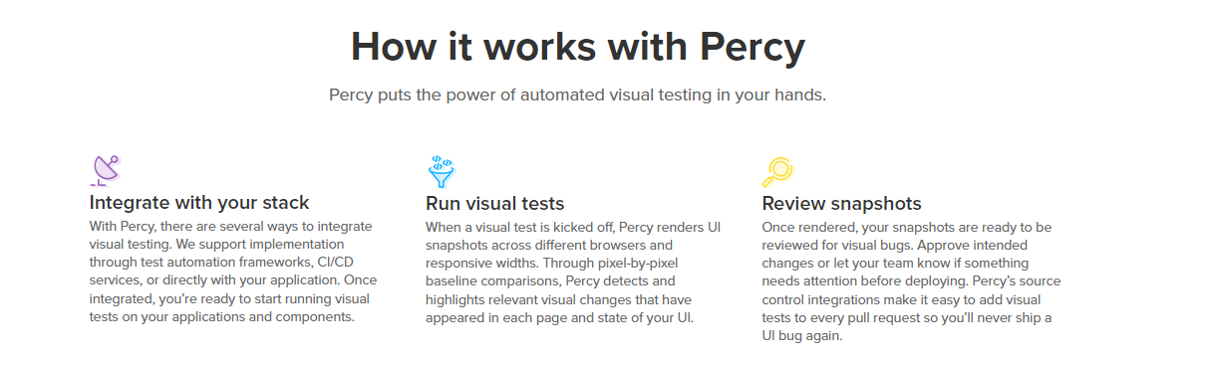
How it works?

Slide 6
Concepts
Projects – Percy Token
Builds
Snapshots
Percy Script
Diffs

Slide 7

Record with Tests
Since there are many tools to use and integrate with you can take advantage of this.
I.e. SeleniumIDE or CypressRecorder can do the work.
Use SiteMaps
Use CLI yml file
Notes:
https://chrome.google.com/webstore/detail/eureqa-qascribe/ddcnflhlcelnooaebapppcbndccfbamj?hl=en

Slide 8

Run Build
Build requires a token per project to build, this needs to be set to your CI or your local env.

Slide 9
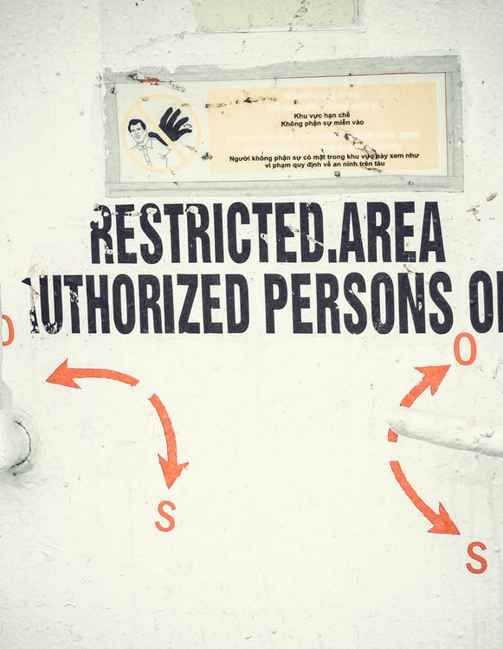
LLEs and Basic Auth
Run Percy with basic Authentication.
Run Percy from LLEs is possible since it upload to the cloud and does not execute from it

Slide 10

Github Actions
Github action can run snapshots!

Slide 11

Export Test Scripts
The tests will be stored on your git repository, percy does not save your test cases, just your snapshots about each build.

Slide 12

Pricing
Free version have some limits, on storage of screenshots and on features, this can be found on the BrowserStack page, this is because percy is one of their products

Slide 13

Known bugs
Test scripts fail but the build still happens (Not a bug, but a feature!)
Receiving build forever!

Slide 14

Workshop
Create github account
Create percy account
Choose a website as target
Create github repo
Create project
Create snapshots

Slide 15
OCC LAD
Obed Murillo

